Slide 1
Manoeuvrability and communication requirements for safe operation when manned and unmanned vessels meet
Ingmar Wever
MSc Thesis Presentation
December 19, 2018

Slide 2
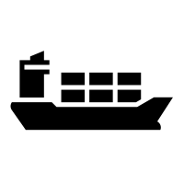

Autonomous shipping (1) - Cognitive
 |  | Course and speed |  | Monitoring of environment | Fallback when automation fails | Automated system in control
0 | No automation
1 | Driver assistance
2 | Partial automation
3 | Conditional automation
4 | High automation
5 | Full automation
Notes:
What is autonomous, unmanned, remote, etc. Define what I’m going to use, and why

Slide 3








Autonomous shipping (2) - Functional
Information
Decision
Action
Manned ship
Remote ship
Automated ship
Unmanned ship
Notes:
Automatisering continue gaande, remote heeft andere toepassing

Slide 4
Reasons for unmanned shipping
Improved safety
Lower cost
Higher productivity
More comfort and attractive industry
Notes:
Push factors, reasons why people want to pay for unmanned

Slide 5
Pull factors
MUNIN
One Sea
Advanced Autonomous Waterborne Applications
Unmanned Cargo Ship Development Alliance
Virtual bridge and remote
Yara Birkeland, Ferry in Finland
Notes:
Projects
Describe the goals of these projects
Show timeline

Slide 6
Challenge of communication between manned and unmanned vessel
Adjust operational strategy
Develop protocol
Notes:
Hoe gaat het autonome schip varen op onze waterwegen tussen bemande schepen
Hoe reageren die andere

Slide 7
Contents
Research methodology
Decision process
Use case
Critical evasive manoeuvre
Foundation
Design specification
Evaluation
Conclusion and recommendations

Slide 8
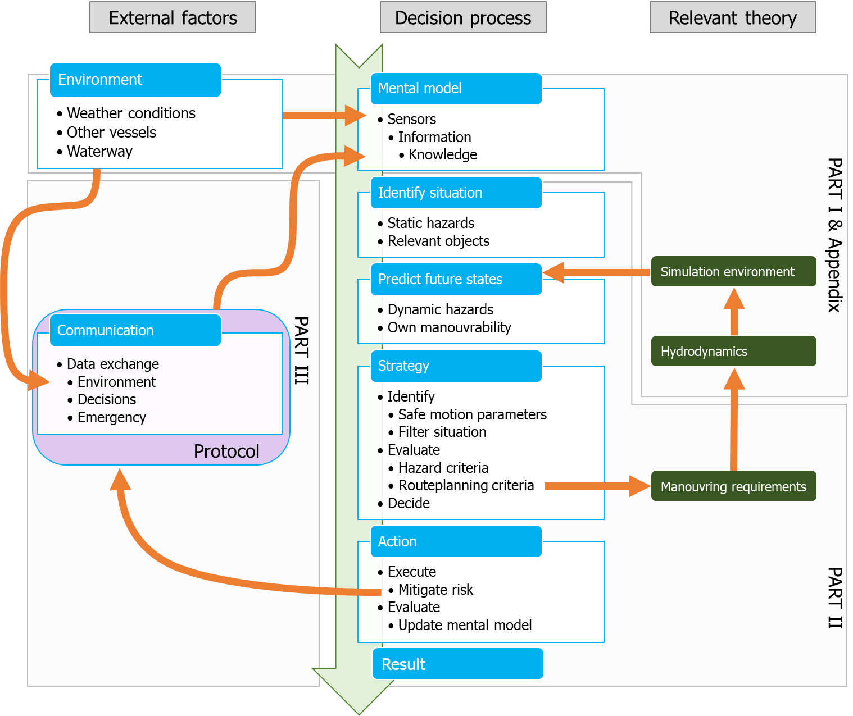
Decision model
Notes:
Explain which parts of the chain I’ll be looking at

Slide 9
Research questions
How do ship manoeuvrability characteristics influence the domain for decision making, to ensure that the chosen strategy will result in a closest point of approach that does not require communication?
Will a protocol based on existing maritime systems and communication protocols be sufficient to ensure safe navigation, while manned and unmanned vessels encounter each other?

Slide 10
Part II: Effect of manoeuvrability on decision making
How do ship manoeuvrability characteristics influence the domain for decision making, to ensure that the chosen strategy will result in a closest point of approach that does not require communication?

Slide 11
Explain what I’m going to look into and develop

Slide 12
Mental model
Identify situation
Predict future states
Action
Strategy
Result

Slide 13
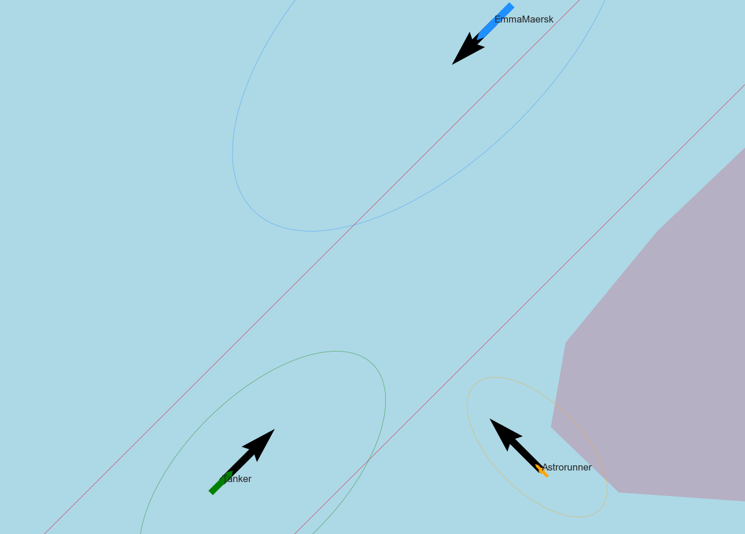
Use case
Explain use case which is used as example
Notes:
Met filmpje/gif

Slide 14
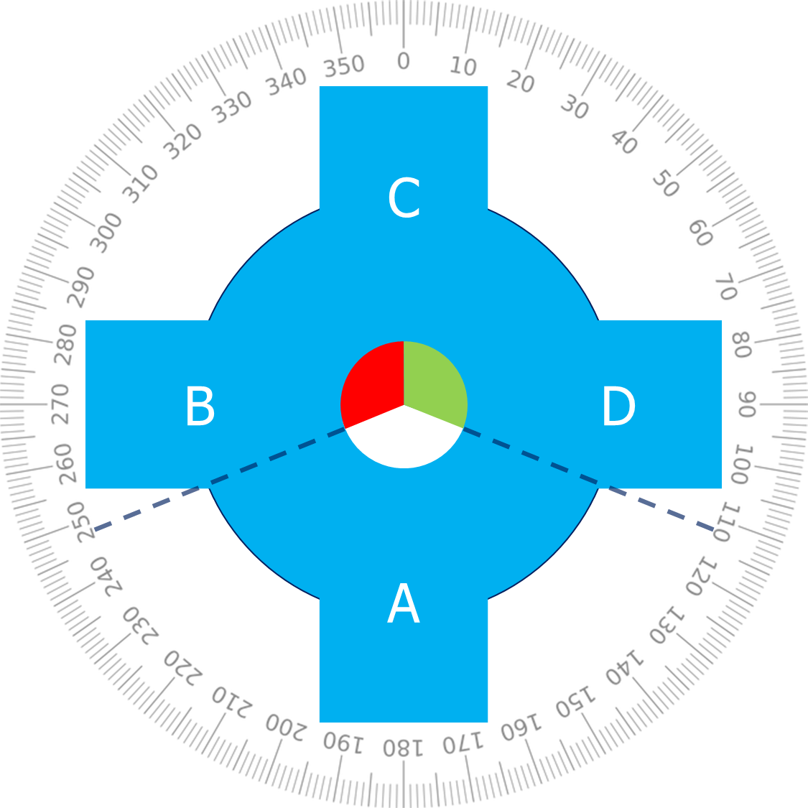
Identify situation

Slide 15
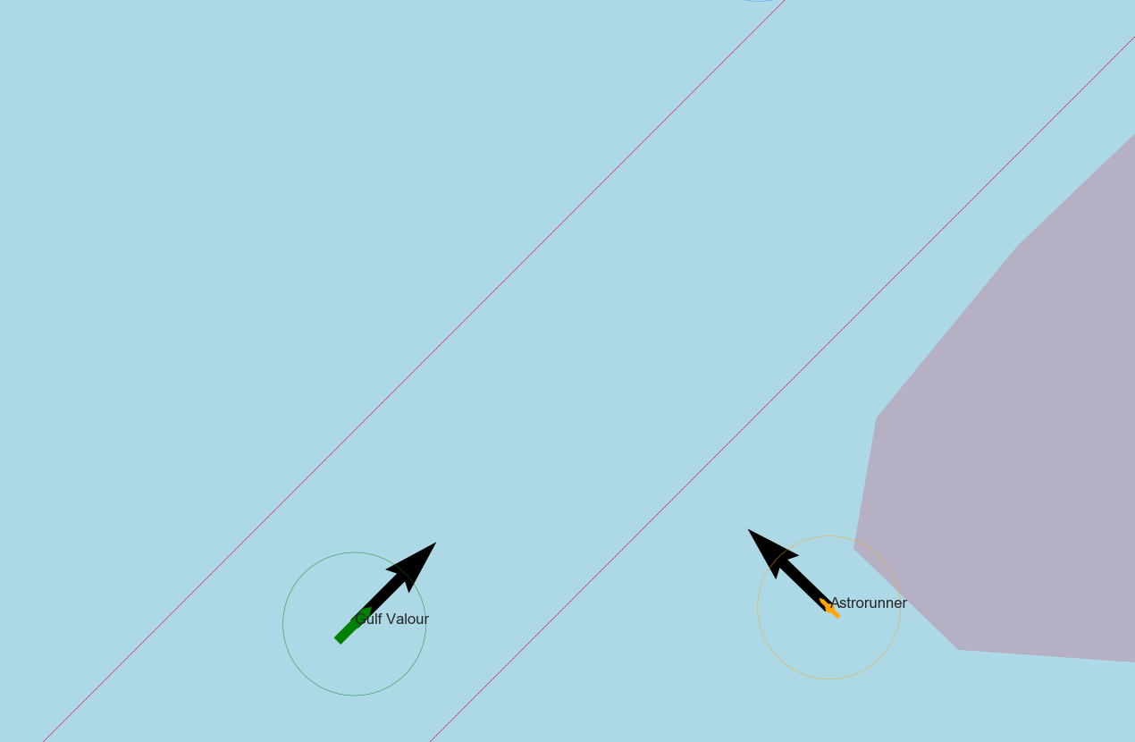
Situation for use case

Slide 16
Criteria
CPA
Passing distance

Slide 17
Evualtion of criteria for use case
why is use case critical

Slide 18
Sea-trials
Explain sea-trials and manoeuvring characteristics

Slide 19
Results of chosen strategy for specific use case

Slide 20
Generalized result for strategy

Slide 21
Conclusion, why does this method work

Slide 22
Next manoeuvres to be tested

Slide 23
Explain it is not always possible, thus communication is necessary

Slide 24
Part III: Necessity of a protocol to enable teamwork between manned and unmanned ships
Will a protocol based on existing maritime systems and communication protocols be sufficient to ensure safe navigation, while manned and unmanned vessels encounter each other?

Slide 25
Necessity for communication
Instructions from external parties
Not in all situations possible to stay well-clear
Notes:
Repeat reasons why communication is necessary

Slide 26
Will a protocol based on existing maritime systems and communication protocols be sufficient to ensure safe navigation, while manned and unmanned vessels encounter each other?
What is a protocol?
Why existing systems?
What is safe navigation?

Slide 27
Role of human
What is situation awareness and how is it acquired?
How to avoid an information overload?
What is required for human computer teamwork?
Notes:
Which human factors should be taken into account

Slide 28
Requirements for protocol
Mention some user stories

Slide 29
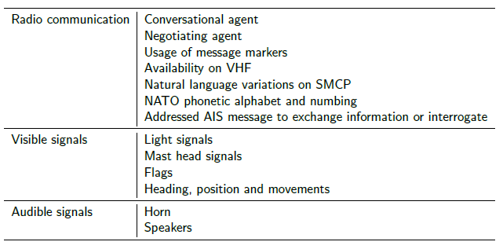
Technologies

Slide 30
Protocol defintion
Status, types of message, speech acts
Use case example

Slide 31
Evaluation method
Describe experiment
Research questions
Participants
Tools
Experiment design
Variables

Slide 32
Do experiment
Do experiment with people in room

Slide 33
Results of evaluation
Results of evaluation
Show how I used the data, example about color for example

Slide 34
Lessons learned from experiment

Slide 35
Discussion of sub-research questions

Slide 36
Conclusion
Will a protocol based on existing maritime systems and communication protocols be sufficient to ensure safe navigation, while manned and unmanned vessels encounter each other?
Notes:
Conclusion about protocol and answer to research questions

Slide 37
The next steps

Slide 38
Conclusion and recommendations

Slide 39
Summary part I

Slide 40
Summary part II

Slide 41
Summary part III

Slide 42
Will the combination of these two solutions solve the challenge of communication?

Slide 43
It looks so, but we have to pay attention to this

Slide 44
With all my student collegeuas in the room, I challenge you to

Slide 45

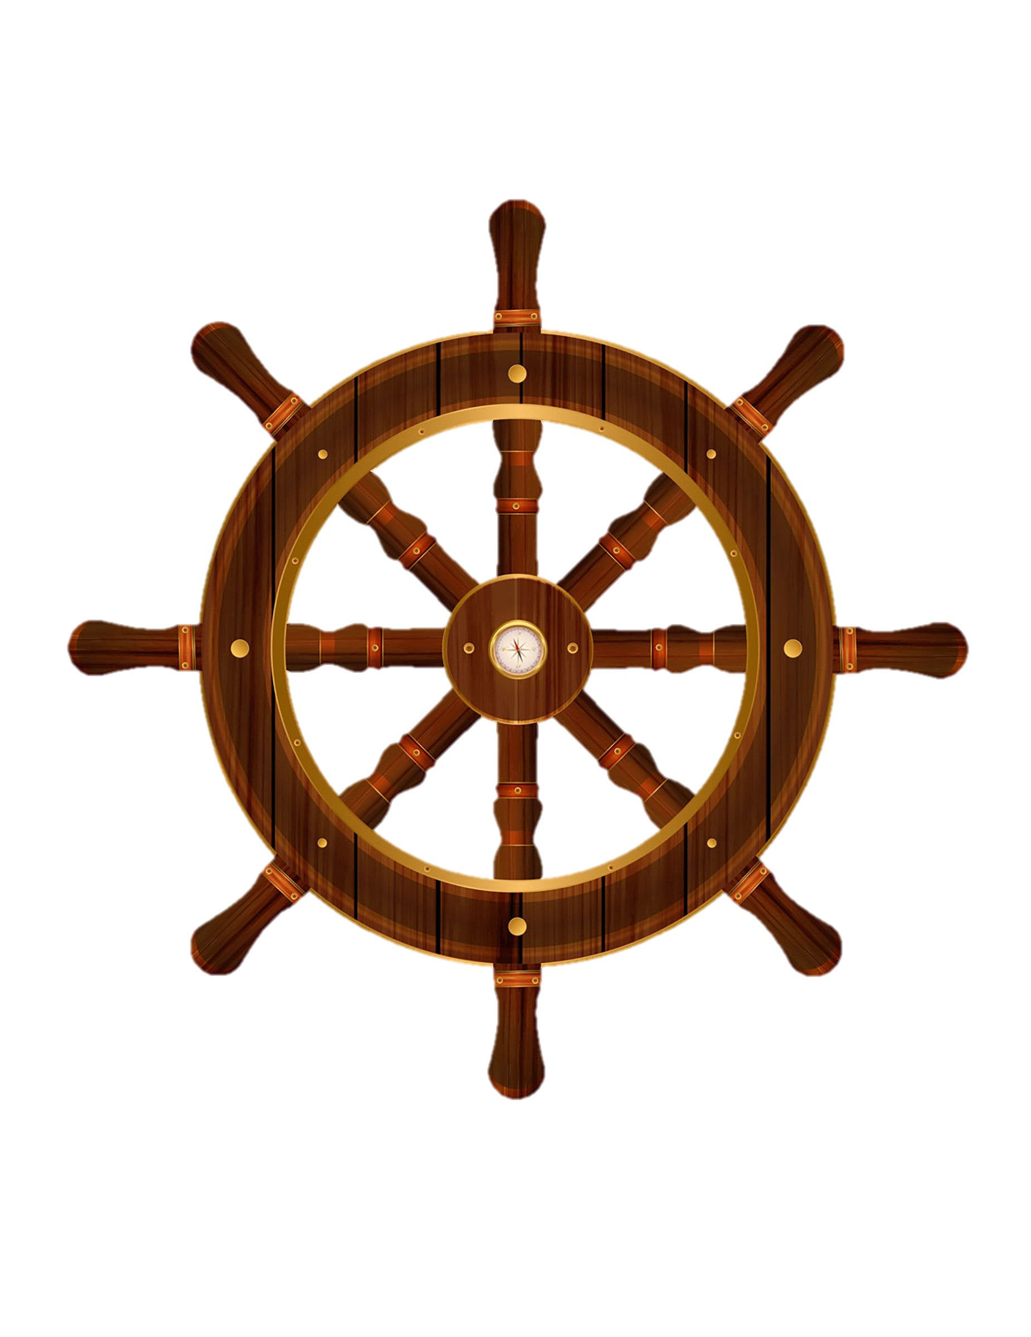



Autonomous shipping responsibility
Level
0
No automation
Notes:
Course and speed
Monitoring of environment
Fallback when automation fails
Automated system in control

Slide 46
Autonomous shipping responsibility
Level
1
Driver assistance
Notes:
Course and speed
Monitoring of environment
Fallback when automation fails
Automated system in control

Slide 47
Autonomous shipping responsibility
Level
2
Partial automation
Notes:
Course and speed
Monitoring of environment
Fallback when automation fails
Automated system in control
No automation
Driver assistance
Partial automation
Conditional automation
High automation
Full automation

Slide 48
Autonomous shipping responsibility
Level
3
Conditional automation
Notes:
Course and speed
Monitoring of environment
Fallback when automation fails
Automated system in control
No automation
Driver assistance
Partial automation
Conditional automation
High automation
Full automation

Slide 49
Autonomous shipping responsibility
Level
4
High automation
Notes:
Course and speed
Monitoring of environment
Fallback when automation fails
Automated system in control
No automation
Driver assistance
Partial automation
Conditional automation
High automation
Full automation

Slide 50
Autonomous shipping responsibility
Level
5
Full automation
Notes:
Course and speed
Monitoring of environment
Fallback when automation fails
Automated system in control
No automation
Driver assistance
Partial automation
Conditional automation
High automation
Full automation

